Slide 1
PLENAIR: CISCO MSP
ALLES WAT JE MOET WETEN OM SUCCESVOL TE ZIJN ALS MANAGED SERVICE Provider PARTNER
Eric van den Berg NL MSP Lead
13 April 2023

Slide 2
Cisco Provider Program
1
2
3
4
5
Cisco Partner Program
Provider Program Requirements & Benefits
Cisco Powered Services
Managed Service Intended Use Tagging
Provider MDF
Overview
Program
MS offerings
Process
Tooling

Slide 3
Cisco Partner Program

Slide 4
How Cisco Partner Program Was Structured
Authorizations
Certifications
Industry Expertise
Specializations
Integrator Program
Solution Technology Integrator
Solution Partner Program
Learning Partner Program
CMSP
Cisco Powered
Incentives
The Cisco Partner Program
Notes:
While we are proud of what we have accomplished together in partner programs, we also recognize that it has been difficult for partners to keep pace with the breadth of so many different stand-alone programs, each with their own Terms and Conditions, anniversary dates, requirements…
This structure has:
Been based too heavily on a Cisco-out view vs a Customer-In view
Put partners in a box defined by how they interact with Cisco
Has been too rigid and administratively heavy
Partners need a program that is better-suited to help them on their profitability journey. One that is easier to navigate and operate. It was time for a bold change; for the most significant change to our partner program in the past decade.

Slide 5
Partner roles in the Cisco Partner Program
Integrator
Build solutions that solve customer business problems, based on your unique expertise.
Provider
Deliver as-a-service and managed solutions with flexible consumption options, powered by Cisco.
Developer
Build unique solutions and applications on Cisco platforms to deliver customer-specific business outcomes.
Advisor
Provide our mutual customers with expert market and business consulting services across the sales cycle.
Notes:
Now, let’s take a high-level look at each of the 4 partner roles.
Integrator: Integrators build solutions that solve customer business problems, based on your unique expertise.
Provider: Providers deliver as-a-service and managed solutions with flexible consumption options, powered by Cisco.
Developer: Developers build unique solutions and applications on Cisco platforms to deliver customer-specific business outcomes.
Advisor: Advisors provide our mutual customers with expert market and business consulting services across the sales cycle.

Slide 6
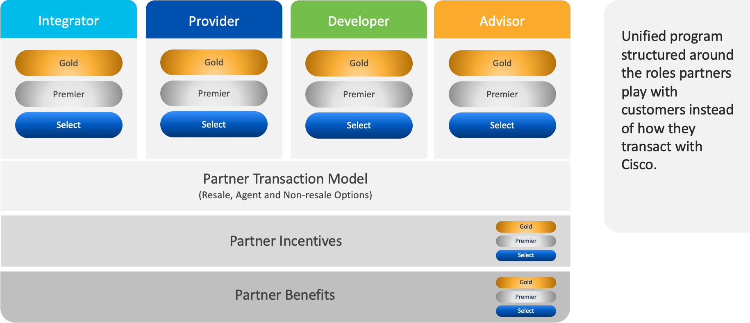
Cisco Partner Program Structure Today
Notes:
While we are proud of what we have accomplished together in partner programs, we also recognize that it has been difficult for partners to keep pace with the breadth of so many different stand-alone programs, each with their own Terms and Conditions, anniversary dates, requirements…
This structure has:
Been based too heavily on a Cisco-out view vs a Customer-In view
Put partners in a box defined by how they interact with Cisco
Has been too rigid and administratively heavy
Partners need a program that is better-suited to help them on their profitability journey. One that is easier to navigate and operate. It was time for a bold change; for the most significant change to our partner program in the past decade.

Slide 7
Provider Program Requirements & Benefits

Slide 8
Provider Eligibility Requirements
Provider Level
Updated eligibility requirements
 | Headquarters (mandatory | Other Location or at Headquarters
MS Practice, Process, Tools, Personnel Role sharing is permitted across all personnel including Customer Success* | An Executive sponsor 2 ITIL Foundation (V3 or higher) certified 1 Cisco MS Practice Lead 2 Cisco MS Management (1 Product Management & 1 Sales Specialist) NOC & Service delivery E2E customer incident management & process for all locations Level 1 Support Collateral in local languages (as needed) Recurring billing capabilities | 1 Sales & Marketing BDM 1 Cisco MS Practice Lead 1 Level 1 Support (local language)
Investment in Cisco offers | Minimum 3 Cisco Powered Services; at least 1 from a list of strategic Cisco Powered services
MS Business Interlock | Minimum once per anniversary year
Customer Success* | Customer Experience Specialization or Advanced Customer Experience Specialization | 1 Customer Success Manager 1 Renewals Manage
Designation | Global (meeting requirements in all regions)
2x ITIL
NOC & Service Delivery
Incident Management process
3x CPS
Customer Experience Specialization
Gold
1x ITIL
NOC & Service Delivery
Incident Management process
1x CPS
MS Practice, Process, Tools, Personnel Role sharing is permitted across all personnel* | 1 ITIL Foundation (V3 or higher) certified 1 Cisco MS Practice Lead NOC & Service delivery E2E customer incident management & process for all locations | 1 Sales & Marketing BDM 1 Level 1 Support (local language)
Investment in Cisco offers | Minimum 1 Cisco Powered Service
Designation | Global (meeting requirements in all regions)
Premier
MS Practice, Process, Tools, Personal | Service Description & Service level agreement (SLA) Remote monitoring and management (RMM) tool Marketing or managed service offer Professional Services Automation (PSA) tool (optional)
Investment in Cisco offers | Minimum one Cisco technology-based managed service (Meraki, Security, Collaboration or EN)
1x ITIL
Remote Monitoring & Management
Service Automation tooling
1x CBS
Select
Notes:
*Role sharing is permitted across all required personnel. See details below
Headquarters (mandatory) • Gold: All 9 roles (includes Customer Experience Specialization) must be fulfilled by a minimum of 4 unique individuals (total). • Premier: 2 roles must be fulfilled by a minimum of 1 unique individual.
Other locations (fulfilled in the country/country group within the region or at headquarters) • Gold: Americas, APJC: All 5 roles per theater must be fulfilled by a minimum of 3 unique individuals. EMEAR: All 5 roles per country/group of countries must be fulfilled by a minimum of 2 unique individuals. • Premier: 2 roles must be fulfilled by a minimum of 1 unique individual per theater in Americas and APJC, and per country/group of countries in EMEAR.
Review “Cisco Partner Program–Provider Role Eligibility Details, Effective FY 2023 (Aug 1, 2022)” for additional information.
**Strategic Cisco Powered services list:
(1) Meraki Access, (2) Meraki SD-WAN, (3) Cisco SD-WAN (Viptela), (4) Secure Access, (5) Cloud Calling, (6) Webex Contact Center, (7) Cloud Managed Security, (8) Meraki Security, (9) Hybrid Cloud, (10) Secure Access Services Edge (SASE)

Slide 9
The benefits of being a Provider
Build and differentiate your practice
Meet customers “where they are” in their journey to digital transformation and infrastructure modernization
Reach new buyers, especially line of business teams, to expand your relevance in your accounts
Tap into a massive market opportunity backed by Cisco
Increase the opportunity to up-sell and cross-sell throughout the customer lifecycle
Premier level benefits, plus:
Advantage of industry-leading Gold brand
Global or Regional Gold Provider designation Options
Cisco-Funded Champion* – PIF
Gold Provider + Cisco Powered services bonus in VIP
Increased opportunity to earn ($$$)
Gold
Select level benefits, plus:
VIP Annuity
VIP Classic, with Cisco Powered Service bonus
CSPP eligibility
Lifecycle Incentive
Cisco Powered branding
Increased opportunity to earn ($$)
Premier
Partner Value
Provider Pricing
Managed Service Deal Registration
Flexible consumption
Provider MDF
Provider Investment Funds*
Perform Plus
NFR
Differentiate as Provider in Cisc Partner Locator
Provider Marketing benefits
Select
^{*By invitation only}
Notes:
As with all the program roles, the Provider role protects existing partner investments. During the February 2021 transition of partners in the Cloud and Managed Services Program (CMSP) to the Provider role, eligible benefits were not impacted.
The existing benefits of the Provider role were created to meet the following objectives:
Empowers and rewards partners pursuing growth, differentiation, and service creation in the managed service market.​​​
Aligns to your growth strategy, whether you are just starting a managed service practice or looking to differentiate your Cisco Powered Service offerings.
Brings together your managed service expertise with Cisco's innovative cloud-based networking, security, and collaboration technologies.

Slide 10
Provider Benefits
Provider Benefit
Provider Programmatic Pricing | ✓ | ✓ | ✓
Managed Services Deal Registration | ✓ | ✓ | ✓
Flexible consumption/MSLA integration | ✓ | ✓ | ✓
Provider MDF | $$$ | $$ | $
PIF | ✓ | ✓ | ✓
Marketing Benefits | $$$ | $$ | $
Branding: Provider & Cisco Powered | Global | Global | Regional
VIP Annuity – Provider Parity | ✓ | ✓ | -
VIP Gold Provider Bonus | ✓ | - | -
VIP Cisco Powered Service Bonus | ✓ | ✓ | -
Perform Plus & Provider Elevate | ✓ | ✓ | ✓
CSPP | ✓ | ✓ | -
Life Cycle Incentive – Provider Parity | ✓ | ✓ | ✓
NFR Provider Parity | ✓ | ✓ | ✓
Gold
Premier
Select

Slide 11
Cisco Powered Services

Slide 12
Cisco Powered Services
Proven Blueprints
Cisco Powered Service are standards that recognize a Provider’s validated competency to build and deliver world-class, multi-architecture managed services and as-a-service offers built on Cisco technologies
Showcase Capabilities
Cisco showcase Providers who have coupled their deep managed service capabilities with Cisco Powered Service standards to drive business outcomes that enhance customer success.
Brand and differentiate your Cisco Powered Service practice with industry-recognized logos and GTM resources.
Sales Acceleration
Cisco Powered Services is a critical component to the Provider role and Providers who invest in Cisco Powered Services earn higher levels of value exchange including upfront programmatic discounts and investment funds, etc
Service Provisioning
Change Management
Proactive Monitoring
Remote Troubleshooting
NOC & SLA
Cisco Powered Services Portfolio Requirements

Slide 13
Cisco Powered Services (Strategic)
Cisco Powered Services Portfolio v9.2
Future of Work | End-to-End Security | Secure Agile Networks | Optimizing Application Experience
Cloud Calling | Cloud Managed Security | Cisco SD-WAN | Hybrid Cloud
Webex Contact Center | Meraki Security | Meraki SD-WAN | Sovereign Cloud
 |  | Meraki Access | Full Stack Observability
 |  | Secure Access
 |  | Secure Access Services Edge (SASE)
Webex for Broadworks
UC aaS based on HCS
CC aaS based on HCS
Business Communications
Unified CC
Cisco Powered Services Portfolio Requirements

Slide 14
Cisco Powered Services
Cisco Powered Services Ingredients, Recipe & Offers
© 2023 Cisco and/or its affiliates. All rights reserved. Cisco Confidential

Slide 15
FY23 PIF Types Targeted Investment
Provider Investment Fund (PIF) – Types
1
2
3
Service Creation
Sales Acceleration
Hybrid
1a
1b
1c
2a
2b
2c
3a
3b
Standard
18-month
Headcount
Large
Small
Headcount
Small
Large
PIF – An Exclusive Benefit for Providers

Slide 16
Managed Service Intended Use Tagging

Slide 17
Managed Services Deal Identification
Why is it important
Managed Services Deal Identification is a flagging feature used in Cisco Commerce (CCW) deals & quotes to flag transactions as a managed service order.
Intended Use Flagging future proofs partner eligibility to earn Provider incentives based on managed services flagged bookings.
The new flag is “Intended Use = Managed Service.”
Supports accurate bookings and financial reporting and alignment to budgeting and Partner program incentives.
Flagging helps to distinguish between a managed service and resale from Quote to Order and provides the ability to track managed versus resale orders.

Slide 18
How to order with Intended Use Flagging
Login to Cisco Commerce
Deal / Quote Creation
Deal / Quote Approval
1
2
3
Login to CCW
Refer to the Ordering Guide for questions on Managed Services Intended Use flagging
Go to Deals and Quotes section
Create Deal in CCW
Select Intended Use = Managed Service
Add Managed Service Contractual Provider Name
Select Incentives (Provider Pricing is decoupled and the user will need to select them manually as well as stack Teaming & Hunting)
Approve deal from CCW
Cisco Account Manager will receive an approval request to review and make appropriate decisions or reach out for additional information
If Intended Use = Managed Service, all relevant info will appear automatically from CCW

Slide 19
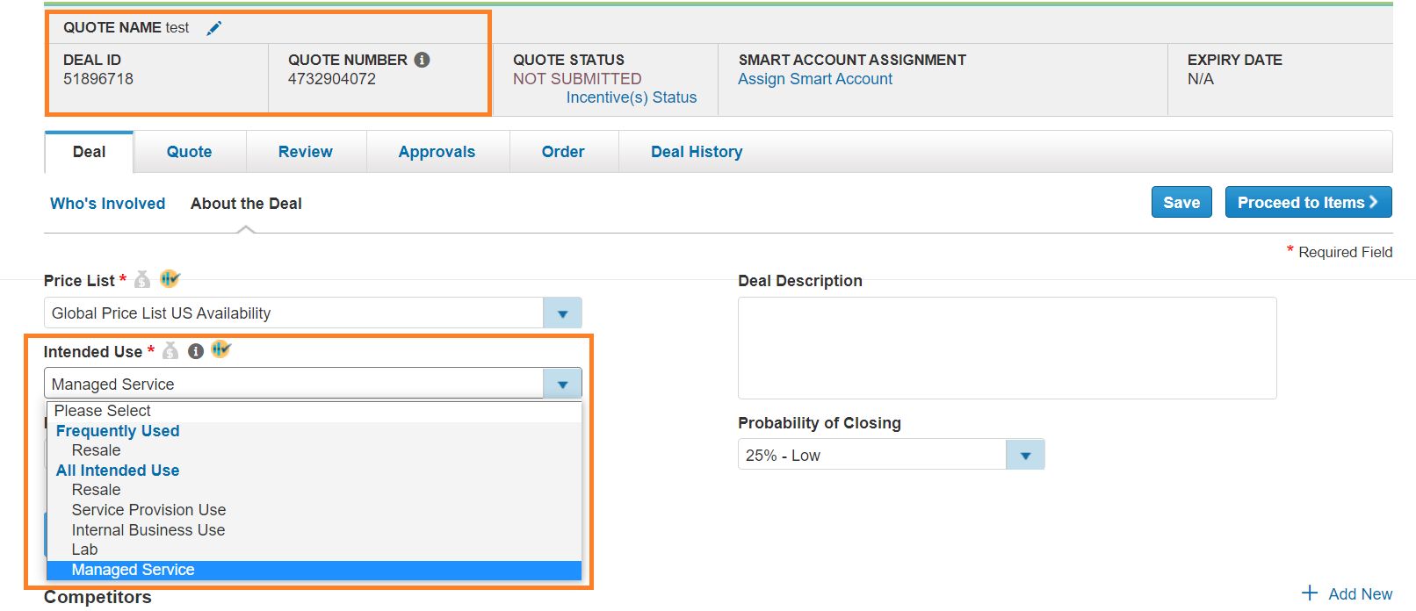
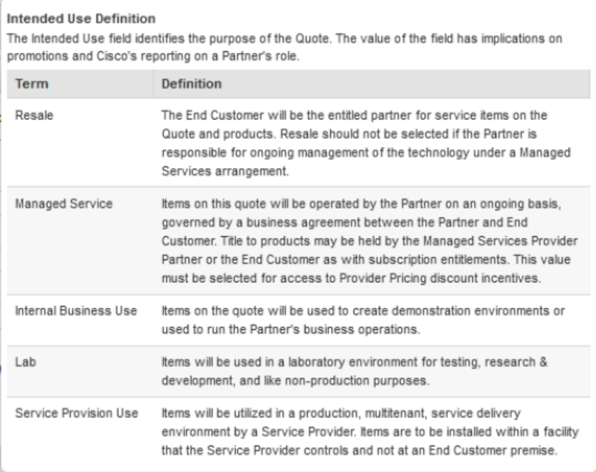
Managed Service Flagging in CCW
Intended Use
Select Managed Service as Intended Use
Updated tool tip

Slide 20
2H FY23 Provider MDF

Slide 21
2H FY23 Provider MDF – Digital Wallet
Select Provider
Premier Provider
Gold Provider
Up to $20,000
Up to $102,500
Up to $160,000
Earnings Calculation
At the end of each quarter; Q3, Q4->Q3+Q4 (CUMULATIVE MS bookings & other eligibility)
If a Provider moves to a higher payout tier in Q4, the difference is paid to the partner in Q4
Products Total Net MS bookings: “Intended Use =Managed Service”

Slide 22
2H FY23 Provider MDF – Digital Wallet
Select Provider
Payout
Eligibility (2H FY23)
Select Providers with a minimum $50K in Cisco Products total net managed services bookings (which have been tagged as “Managed Services” during Product ordering in CCW)
Earn $2.5K to $20K (Maximum)
$500K+
$200K to $500K
$100K to $200K
$50K to $100K
$20,000
$10,000
Cisco Products Total Net Managed Services Bookings
“Intended Use = Managed Service”
$5,000
$2,500
Minimum $50K in MS Bookings

Slide 23
2H FY23 Provider MDF – Digital Wallet
Premier Provider
Payout
Eligibility (2H FY23)
Premier Providers with a minimum $150K in Cisco Products total net bookings (which have been tagged as “Managed Services” during Product ordering in CCW) & offer at least one strategic Cisco Powered service (see below)
Cloud Calling
Webex Contact Center
Cloud Managed Security OR Meraki Security
Cisco SD-WAN OR Meraki SD-WAN
Meraki Access
Secure Access
Secure Access Services Edge – SASE
Hybrid Cloud
Full Stack Observability (FSO)
Sovereign Cloud
Earn $25K to $102.5K (Maximum)
$10M+
$5M to $10M
$2M to $5M
$500K to $2M
$150K to $500K
$100,000
$102,500
$70,000
$72,500
Cisco Products Total Net Managed Services Bookings
“Intended Use = Managed Service”
$47,500
$50,000
$32,500
$35,000
$25,000
$27,500
Number of Strategic CPS →
1
2+
Minimum $150K in MS Bookings & offer at least one strategic Cisco Powered Service

Slide 24
2H FY23 Provider MDF – Digital Wallet
Gold Provider
Payout
Eligibility (2H FY23)
Gold Providers with a minimum $150K in Cisco Products total net bookings (which have been tagged as “Managed Services” during Product ordering in CCW) & offer at least one strategic Cisco Powered service (see below)
Cloud Calling
Webex Contact Center
Cloud Managed Security OR Meraki Security
Cisco SD-WAN OR Meraki SD-WAN
Meraki Access
Secure Access
Secure Access Services Edge – SASE
Hybrid Cloud
Full Stack Observability (FSO)
Sovereign Cloud
Earn $30K to $160K (Maximum)
$10M+
$5M to $10M
$2M to $5M
$500K to $2M
$150K to $500K
$130,000
$135,000
$145,000
$160,000
$90,000
$95,000
$105,000
$120,000
Cisco Products Total Net Managed Services Bookings
“Intended Use = Managed Service”
$60,000
$65,000
$75,000
$90,000
$40,000
$45,000
$55,000
$70,000
$30,000
$35,000
$45,000
$60,000
Number of Strategic CPS →
1
2
3
4+
Minimum $150K in MS Bookings & offer at least one strategic Cisco Powered Service

Slide 25
Provider Market Development Fund (MDF) for Cisco MS Business
Gold
Premier
Select
Wallet Menu
Business Development / GTM |  |  | Marketing
Cloud or Network Assessments (Customer opportunity visibility) | Partner Level Specialization (Courses, exams for CPS Specialization) | Market Research / Predictive Analytics | Marketing (Digital/Non-Digital)
Funded Heads | Sales Incentives | Sales Call Out Days | Marketing Automation (tools/platforms to manage campaigns, activities)
Individual Career Level Certifications | Seminars and Events with Internal / External Audience | Solution Center (tour, training) | Merchandising / Telemarketing
Managed Service (Cisco) GTM Review or GTM Workshop | Third-Party Trade Shows
2H FY23 Provider MDF Terms & Rules

Slide 26
Provider MDF – Partner Action
0
1
2
3
User Access
Activity Creation
Claims Submission
Payment
Partner Self Service (PSS)
MVC Portal
Global Easy Pay
Review Provider Terms & Rules

Slide 27
Provider MDF – Partner Action
0
1
2
3
User Access
Activity Creation
Claims Submission
Payment
Partner Self Service (PSS)
MVC Portal
Global Easy Pay
Locate your Partner Self Service (PSS) Admin
Partner User access to Provider MDF (by PSS Admin)
Note: One time setup
Click on Fund Name (xx xxxx Provider MDF)
Click “Acknowledge Funds” and Accept T&Cs (once for funds earned in each Q)
Update Finance & Partner Contacts – Partner Relationship button
Add Activity(ies) to your Plan
Click on “W” (top left)
Find your activity
Submit Claim (post execution) - Upload PoP/ PoC
Claim Approved
Receive GEP Notification
Follow directions on notification to submit "payment" claim
Submit bank details and *invoice (where applicable)
Receive confirmation notification
Provider MDF - Funds Manager Training
gep_q2training (cisco.com)

Slide 28
Summary

Slide 29
Summary
1
2
3
4
5
Cisco Partner Program
Provider Program Requirements & Benefits
Cisco Powered Services
Managed Service Intended Use Tagging
Provider MDF
Overview
Program
MS offerings
Process
Tooling

