Slide 1
DNA/SDA Playbook DNA/SDA Useful Resources for Partner Enablement and Support February 2020

Slide 2
SD-Access Learning Phase
SDA Resource Center - Central Repository for partner focused SDA materials
Cisco Learning Library - VoD DNA Center trainings
SD-Access Solution Overview - Short introduction to Business value of SD-Access
SDA Blue e-Book - Introduction to SD-Access Solution and Architecture components
SDA Migration Guide – Migration existing networks to SD-Access considerations
dCloud Instant Demo - Interactive DNA-C 1.3 based Demos (demo /demo1234! ) Demo Guides
Cisco Live BRKCRS-2810 - SD-Access A look under the Hood
Cisco Live BRKCRS-3810 – SD-Access Deep-Dive
Youtube SD-Access Channel - Collection of short videos on SD-Access use-cases
Cisco Live BRKEWN-1501 – SD-Access Campus Deployment using CVD
Cisco Live BRKEWN-2020 - SD-Access Wireless Integration
SDA Ordering Guide - SD-Access Ordering Guide
Cisco DNA Subscription - Cisco DNA Subscription and Licensing
SDA
Introduction
Cisco Learning Library - Training Plans & Certification Training
Cisco Live BRKARC-2009 - Intro to IBN SDA network
EMEAR Partner Readiness - EMEAR Partner Community for EN : PIW, Webinars, PVTs…
Some EMEAR EN PVT sessions - refreshed every 6 months as per SEVT/PVT cycle
EMEAR EN PVT - SDA/C9k Deployment Lessons Learned
EMEAR EN PVT - Cisco SD-Access Migration
EMEAR EN PVT - Cisco SD-Access Best Practices and Use Cases Part 1
EMEAR EN PVT - Cisco SD-Access Best Practices and Use Cases - Part 2
Black Belt Access Learning Map
VOD
Resources
Virtual Trainings and Certifications
Sales Connect Enterprise Networking - Partner Enterprise Networking Sales Resources
EMEAR EN PVT - Cisco SD-Access Innovations

Slide 3
SD-Access Planning and Design Phase
Service
Offerings
SDA Community - SD-Access Support Community
HLD and Compatibility Matrix
SDA HLD document - SD-Access HLD Template
Best Practice Guides
SDA Design Best Practice - Cisco SD-Access Best Practice Positioning
CVD SDA Solution Design Guide – Cisco SD-Access Design Guide
CVD SDA Deployment Guide – Cisco SD-Access Deployment Guide
CVD SD-Access Segmentation Design Guide - Cisco SD-Access Segmentation Guide
CVD Wireless Design & Deployment Guide - Cisco SD-Access Wireless Integration Guide
CVD Encrypted Traffic Analytics - Cisco Encrypted Traffic Analytics Deployment Guide (non-fabric)
SDA Design PlayBook - Customer Requirements Doc (CRD) & High Level Design (HLD)*
SDA Compatibility Matrix - SD-Access Product Compatibility
DNA-Center Compatibility - DNA-Center Supported devices
Work with Cisco SE and CX team on design and Hardware selection
SDA Design Help-Desk - request access for Implementation Best Practice and HLD Review consultation
Cisco Services for Design and Implementation - Services for Enterprise Networks
Cisco Solution TAC Support Information - Cisco Solution Support
Always Evaluate CX Cisco Services for Design and Implementation
MINT Services http://cs.co/MINT - Cisco Mentored Install Network Training
*(currently internal document. Working internally to make it public)

Slide 4
SD-Access Implementation Phase
Document all test use-cases and requirements (review HLD and Compatibility matrix)
Solution
Validation
Install and
Config Guides
In Production and Troubleshooting
Support Case Manager - Engage Solution TAC for assistance when issues are found (Select Technology by Typing “DNA” )
Review with Cisco if required
Ensure correct Software Selection - SDA Software Compatibility Matrix
Review software release notes prior to upgrades
Complex deployments should consider POC or leverage Cisco Solution Validation Services
User Guide for DNAC - Cisco DNA Center User Guide, Release 1.3
DNAC Install Guide - Ciso DNA Center Install and Upgrade Guides
DNAC Administrator Guide - Cisco DNA Center Admin Guide
Trouble-shooting videos: Trouble-shooting videos created by TAC
Check for Cisco Live Troubleshooting Sessions
Leverage DNAC Assurance application to monitor client connectivity, Fabric, Control plane and CPU Health
SDA Design Help-Desk - request access for Implementation Best Practice and HLD Review consultation
DNAC Release Notes - DNA-C Release Notes
DNA-C 1.3.3 Data Sheet – Latest features and capabilities included in 1.3.3
How to deploy SD-Access – Step by step to start building a SD-Access network
Additional SD-Access related Guides

Slide 5
SD-Access Additional Resources
EN Dynamic Bundles for SMB (Meraki, SMB Switches, APs and routers, Security Appliances) September 30, 2019
DNA
Promotions and Starter Kits
Cisco DNA Center
Cisco DNA Center
Cisco DNA Advantage Access Bundles with Wireless January 25, 2020
Cisco DNA upgrade from lower to higher Tier July 25, 2020
Cisco DNA Starter Kit with or without Wireless July 25, 2020
Free Cisco DNA appliance for Enterprise Agreements over 100k$ July 25, 2020
Up to 26% off for migrating to Cisco DNAC for customers with APIC-EM-HW-APL-G or APIC-EM-HW-APL-R July 25, 2020
Education and public libraries offers (US only) Undetermined
1yr Cisco DNA licenses for government customers buying C9000 and Aironet/Catalyst APs Undetermined
http://www.cisco.com/go/dnacenter
(Partners) http://cs.co/DNACenterForPartners
(Partners) MINT Services http://cs.co/MINT
(Partners EMEAR) http://cs.co/EMEARPartnerReadiness-EN
Cisco DNA Center Platform
https://developer.cisco.com/dnacenter/
https://developer.cisco.com/ecosystem/dnacenter/
https://learninglabs.cisco.com/tracks/dnacenter-programmability
https://learninglabs.cisco.com/tracks/dnav3-track
https://developer.cisco.com/events/
https://developer.cisco.com/dnacenter/multivendorsupport/ (downloads under 'getting started'')
https://developer.cisco.com/docs/dna-sdk-docs
Cisco DNA Center Device Support SDK

Slide 6
EMEAR Partner Enablement Instructor-led and Virtual EN/SDA trainings
Octavian Dumitrescu
EMEAR EN Architecture Lead - Partner Readiness

Slide 7
Program Platforms
Partner Workshops
Partner Virtual Team (PVT)
Partner Webinars (PIW)

Slide 8
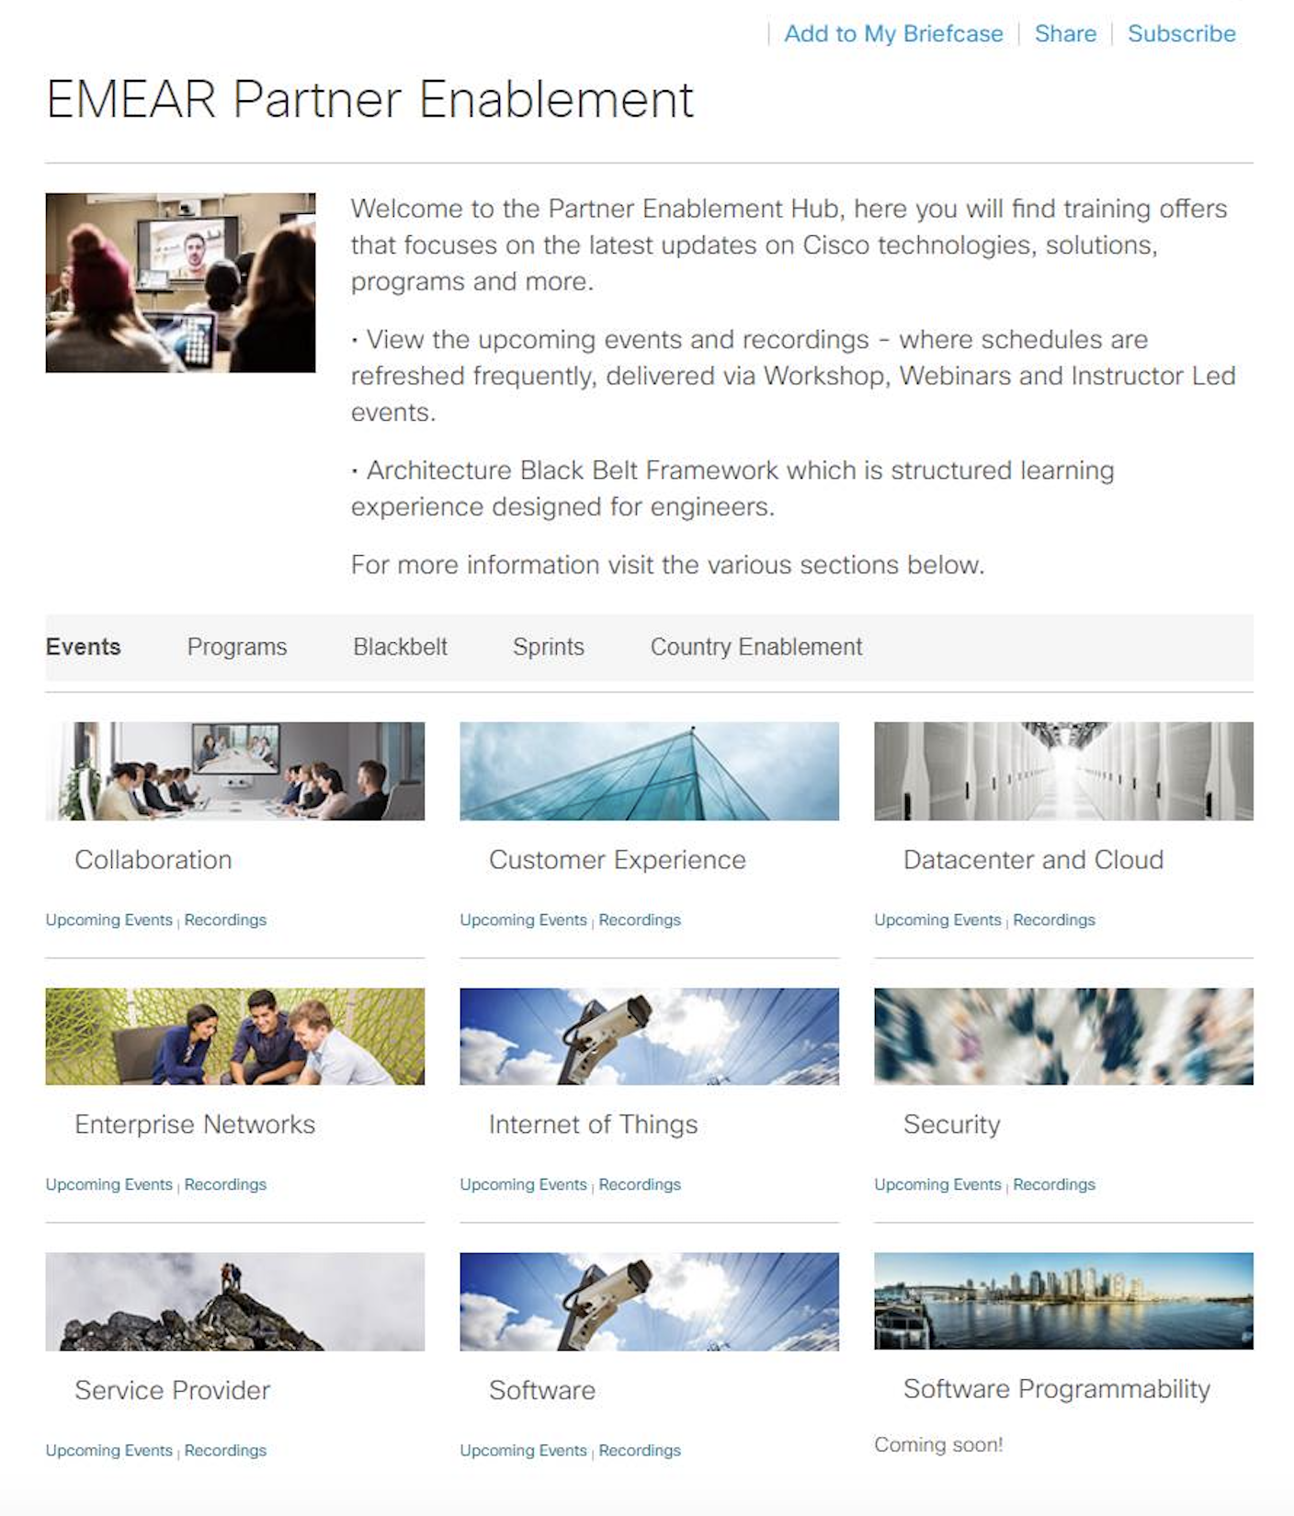
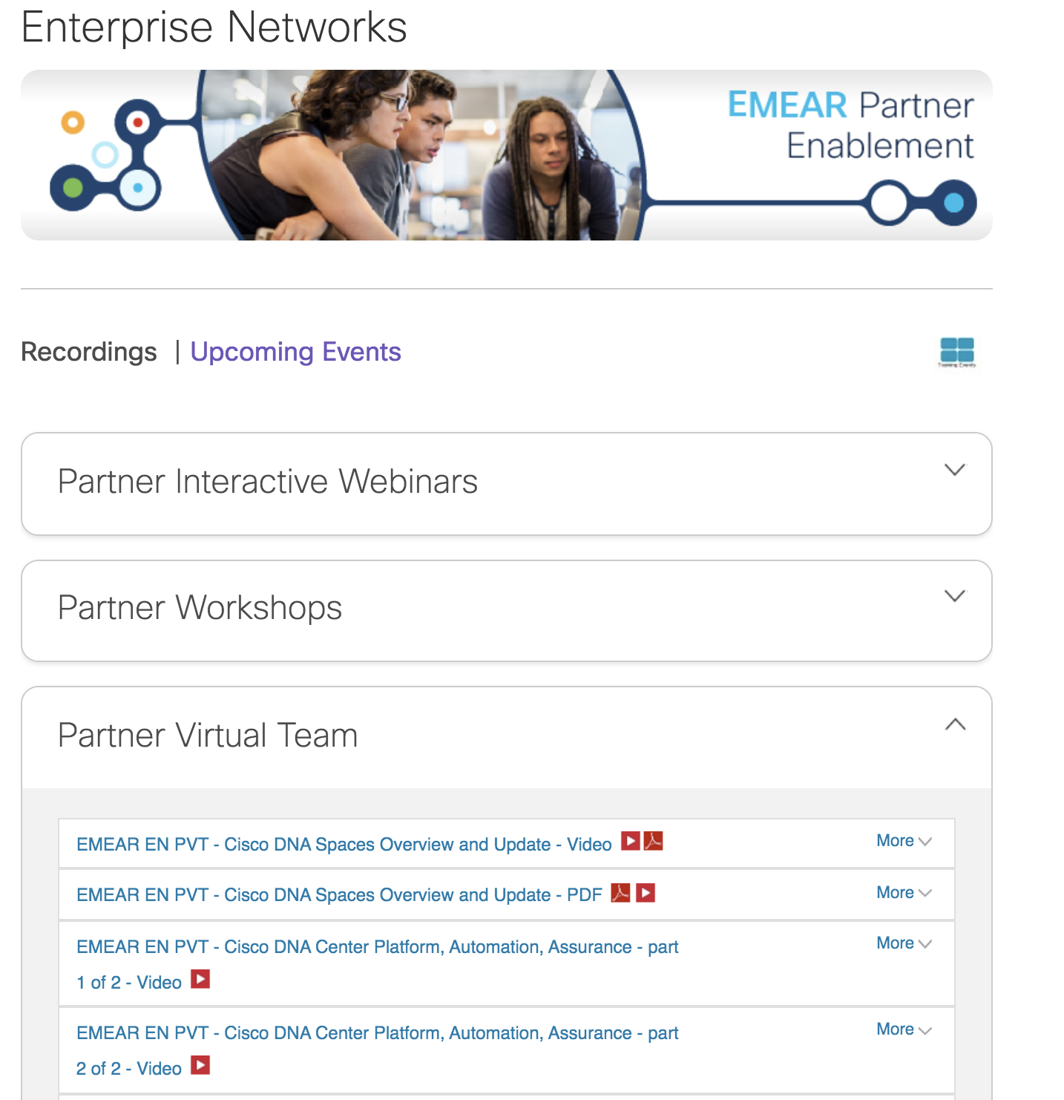
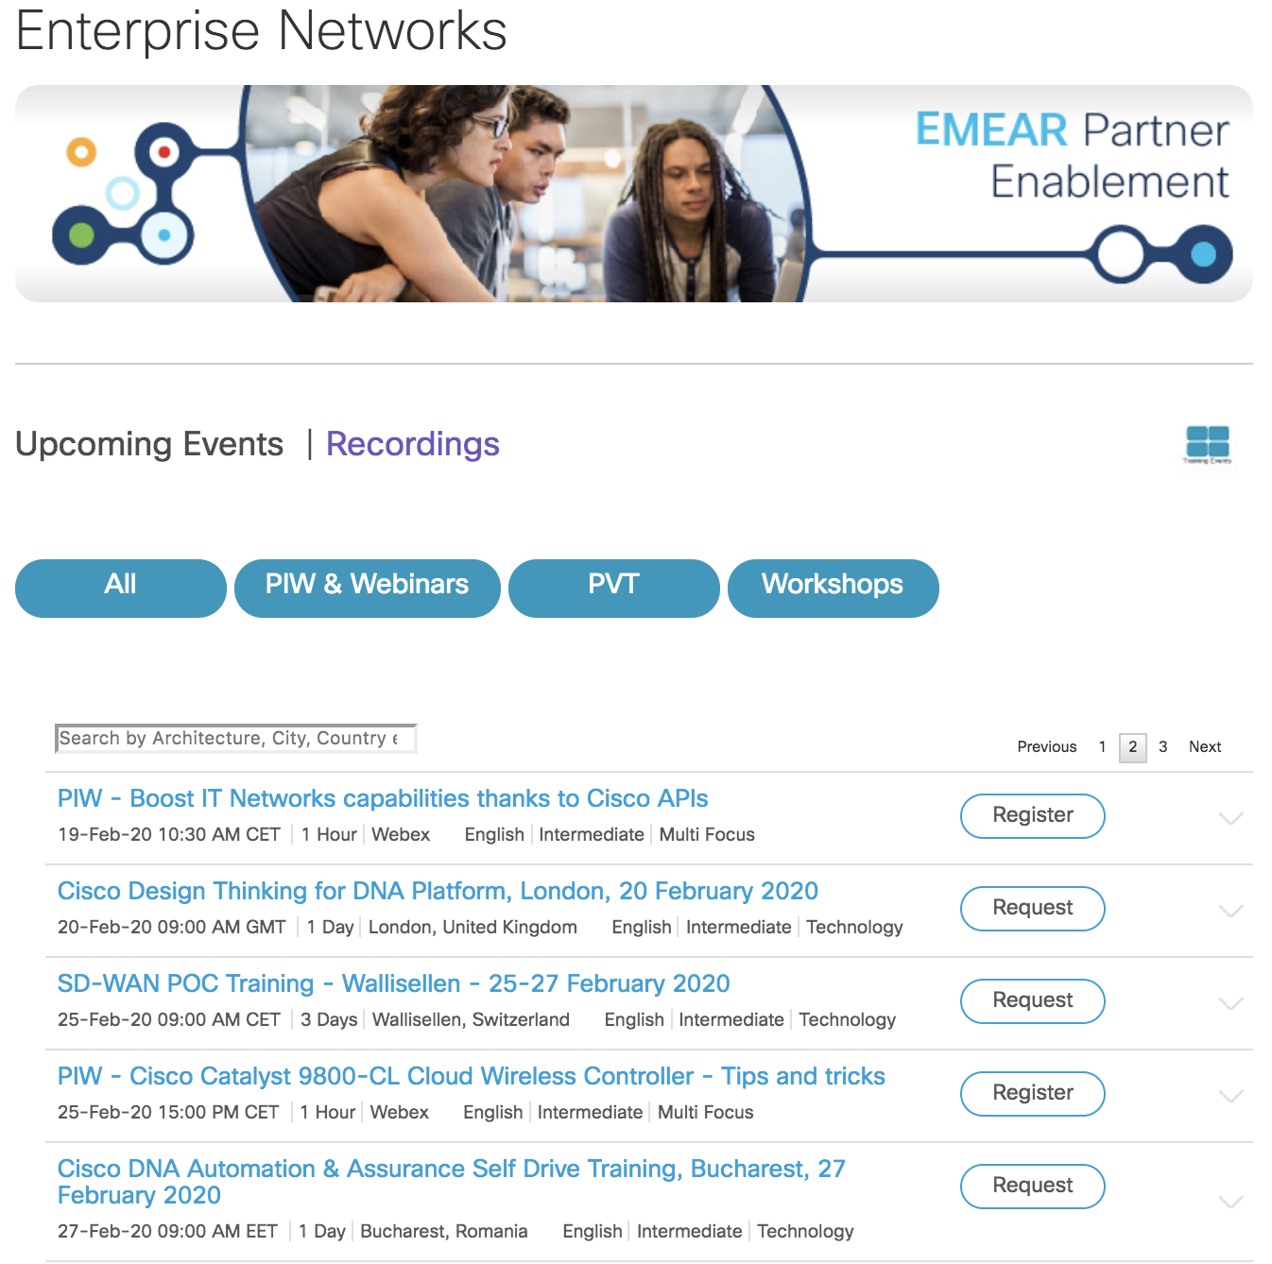
EMEAR Partner Enablement - Hub
http://cs.co/EMEARPartnerEnablement
cs.co/EMEARPartnerEnablement

Slide 9
Enterprise Networking: Partner Training Options
 | Cisco SD-WAN Partner Pre-Sales Training | Cisco DNA Automation & Assurance Training | Cisco Secure SD-WAN Solution Training PoC/PoV | TNI Technical Bootcamp
Focus | SD-WAN Presales | Cisco DNAC Presales | Cisco SD-WAN Postsales Deep Dive Design & Deployment | Cisco DNAC/SDA/SDWAN Postsales Deep DIve
Duration | 1 day | 1 Day | 3 days | 4 days
Participants | 16-20 Pre-sales engineers Product sales specialists Business development managers Account managers | 16-20 Presales engineers Businsess development managers Systems engineers | 16 Network Architects Systems engineers Pre-sales engineers responsible for PoC/PoV initiatives | 16 Field Engineers Network Architects Systems engineers
Prerequisites | CCNA R&S Knowledge SD-WAN Black Belt Stage 1 | CCNA R&S knowledge and network operations fundamentals Cisco DNA Black Belt Stage 1 | CCNA R&S Knowledge SD-WAN Black Belt Stage 1 | CCNA R&S knowledge and network operations fundamentals Cisco DNA Black Belt Stage 1 Cisco SD-WAN Black Belt Stage 1
Logistics | Delivered by Learning Partner in Cisco Office or Partner Off. | Delivered by Learning Partner in Cisco Office or Partner Office | Delivered by Learning Partner in Cisco Office or Partner Office | Delivered by Learning Partner in Cisco Office or Partner Office
Curriculum | • How to position Meraki SD-WAN and Cisco SD-WAN. • SD-WAN Use cases • Cisco SD-WAN licensing including EA. • Prepare Cisco SD-WAN BoMs • Differentiate Cisco SD-WAN solution from the competition | • Cisco DNA Automation features • Cisco DNA Assurance features • Cisco DNA Platform and Integrations • Cisco DNA Supported Platforms • Cisco DNA System Specifics (High Availability, Disaster Recovery, ...) • Cisco DNA Licensing | Cisco SD-WAN Overview Cisco SD-WAN Solution Arch Controller Deployment Options Data Plane Bring-up Configuration Templates Control Policies (Lab) Data Policies (Lab) Application Aware Routing (Lab) …much more… | • Day 1: DNA Center Programmability, Automation, Analytics • Day 2: Software Defined Access • Day 3: DNA Security • Day 4: SD-WAN

Slide 10
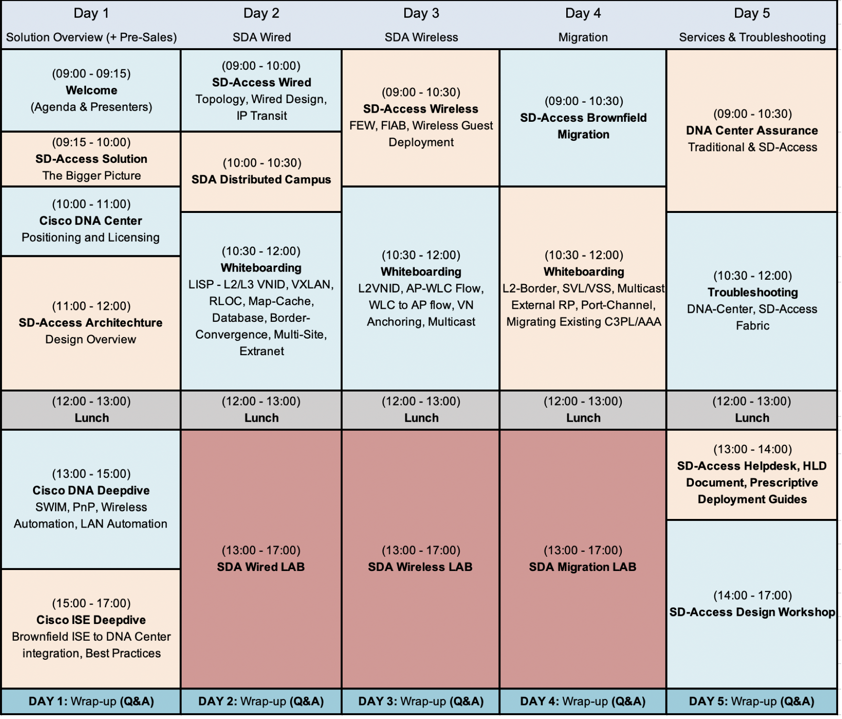
Cisco SDA Design & Deployment 5-day Training
Overview
Logistics
Design, implement and deploy a secure SDA fabric solution for complex wired and wireless infrastructure + SDA troubleshooting techniques.
Number of Participants 30 students – 15 Lab Pods
Target Audience: EN Field Engineer / Practice Lead
Location: Delivered by BU TME or Cisco Learning Partners in Cisco Office
Recommended Training & Prior Knowledge
CCIE Routing & Switching, CCNP Routing & Switching, Cisco Blackbelt SDA Deployment Stage 1
Sessions Scheduled for FY20Q3:
Germany, 17-21 Feb
Switzerland, 9-13 Mar
Netherlands, 16-20 Mar
UK, 30-3 Apr
Training Agenda

Slide 11
EMEAR Enterprise Networks TAC Workshop 24-26th march
Overview
Logistics
3-day event covering TAC troubleshooting methodology, tools and best practices for Wifi/SDA-DNAC/SD-WAN solutions. Each day will include presentations/Lectures in the morning(also streamed via Webex) and labs in the afternoon.
Number of Participants Up to 28 Live attendance on site + Webex for Lectures
Target Audience: Post Sales Partner Field Engineers specializing in SDWAN / SDA & DNAC and Wifi
Location: Delivered by Cisco TAC Team in Cisco Brussels Office, Belgium
.
Day 1 - Wifi
Day 2 – DNAC/SDA
Day 3 – SD-WAN
Morning Lecture 4h
Wireless deployment best practices and the whys.
Presenter : Tiago Antunes + Michal Kowalik
Troubleshooting 9800 controllers:
-Introduction
-Architecture
-Life of a packet
-Design discussions
-Troubleshooting IOS-XE : always on logging, Radioactive traces, ...
-Troubleshooting tools on 9800
-Troubleshooting examples
Afternoon Lab 4h
Single 9800 troubleshooting lab.
Morning Lecture 4h
DNA Center System Architecture:
- System architecture overview
- DNA-Center High Availability
- LAN Automation/PnP & SWIM
DNA Center TAC Troubleshooting & Best practices:
- System 360 Overview
- Cluster health-check
- Upgrades
- LAN Automation
- SWIM
- Assurance
- Inventory
- ISE/pxgrid integration
Afternoon Lab 4h
SD-Access - Wireless configuration & troubleshooting thru DNA-Center Assurance + tools learned during the lectures touching multiple SD-Access Wireless components.
Morning Lecture 4h
Technical Intro
Deployment and troubleshooting
Control-plane -
ZTP / bootstrapping, PNP portal
SUDI & Cloud based deployments
Control connections troubleshooting and best practices
Dataplane
Edge Health
Controllers - vmanage system check [+ backend vmware monitoring]
cEdge templates push problems [20-30 minutes]
API troubleshooting?
Vmanage clustering - disaster recovery
TAC cases: What to collect?
Best Practices/Tunnel scaling / parameter tuning/
Brown field migration/underlay integration NAT / pitfall / practices
Afternoon Lab 4h
Advanced SDWAN troubleshooting

